Slide 1

Artificial Intelligence (AI101B) Even Semester Session 2024-25
Tic Tac Toe(Exploring AI in Strategy Games)
Arun Kumar(202410116100043)
Ayushi Saran Singh(202410116100048)
Akanksha Dwivedi(202410116100012)
Anshu Patel(202410116100034)
Project Supervisor:
Mr. Apoorv jain
Assistant Professor

Slide 2
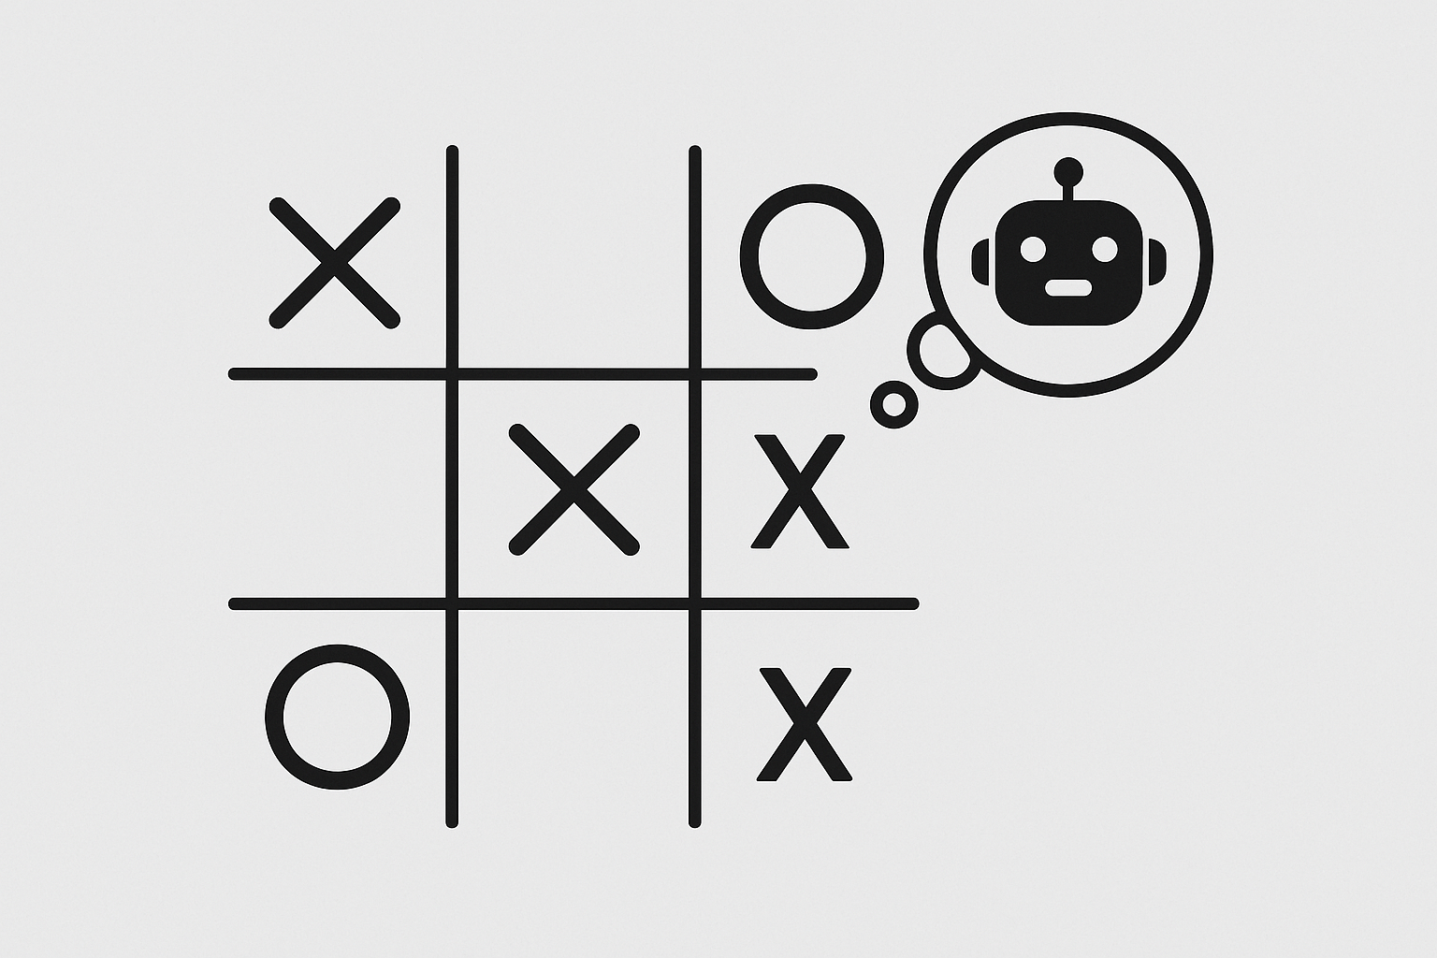
Introduction
What is Tic-Tac-Toe?
A classic 3x3 grid-based strategy game.
Players take turns marking ‘X’ or ‘O’.
The goal: get three in a row to win.
Objective of this project:
AI-Driven Gameplay
Minimax Algorithm
Strategic Decision-Making
Application in Game Development

Slide 3
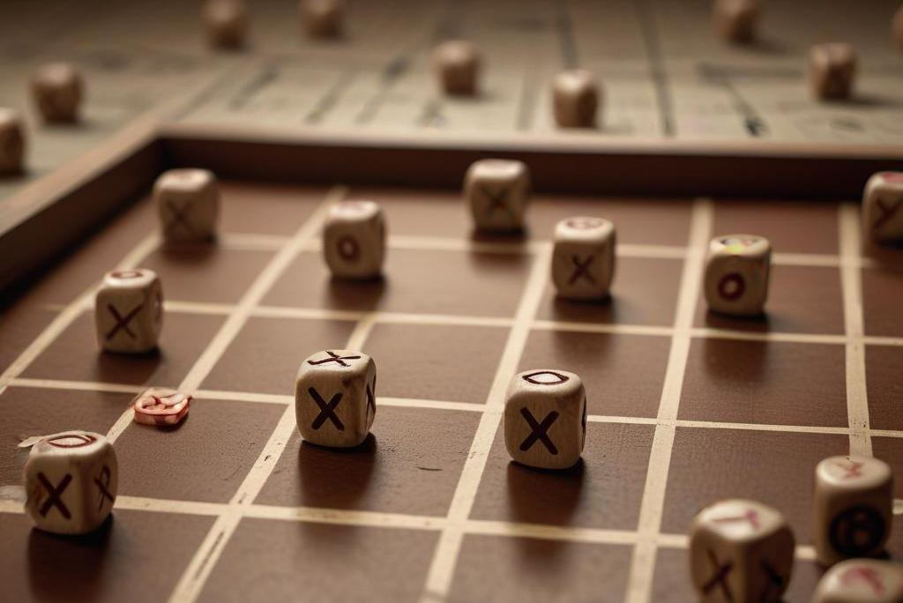
Project Overview
Type of Project:
Console-based / GUI-based / AI-powered (minmax algorithm).
Scope:
Implements core game logic and user interaction.
AI-driven opponent for single-player mode.
Target Audience:
General users, beginners in programming, and AI enthusiasts.

Slide 4
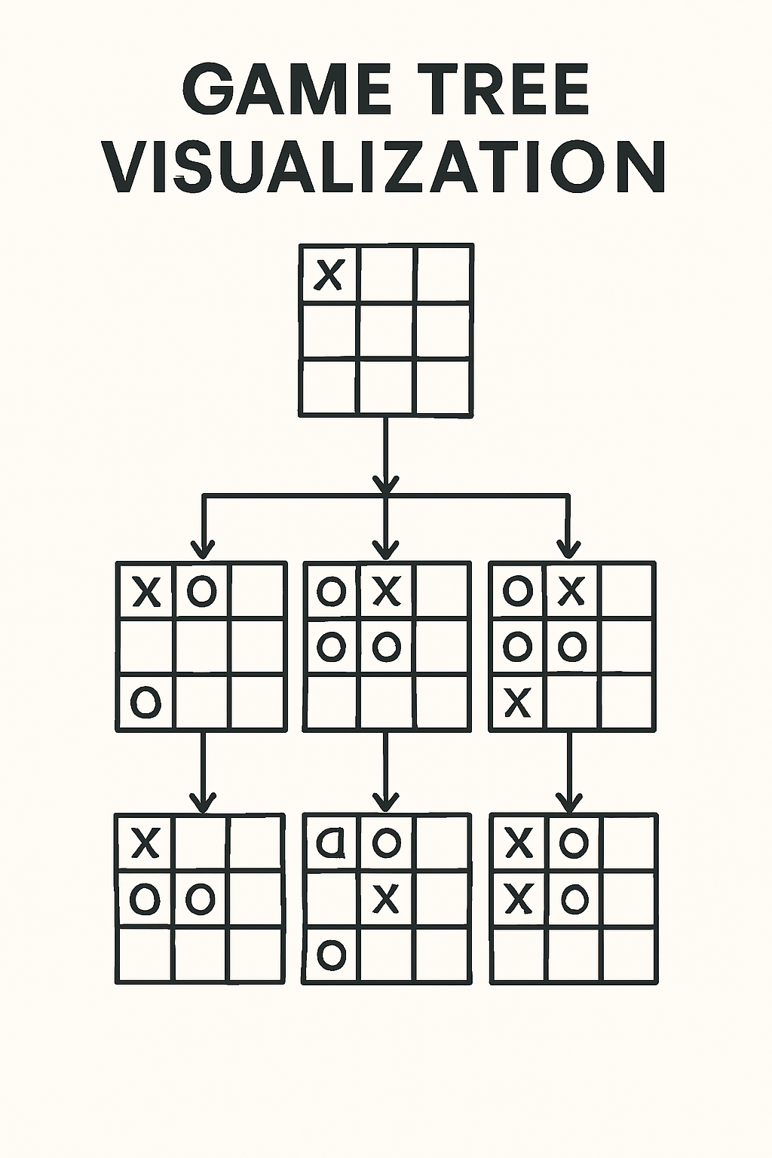
Game Rules and Mechanics
Basic Rules:
Two players take turns placing ‘X’ or ‘O’.
The first player to align three marks in a row (horizontal, vertical, or diagonal) wins.
If all squares are filled with no winner, it’s a draw.
User Input & Validations :
Players can only select empty cells.
Turn-based system ensures proper gameplay flow.
Strategic Gameplay : Players must strategically place their marks to form a winning line while preventing their opponent from winning.

Slide 5
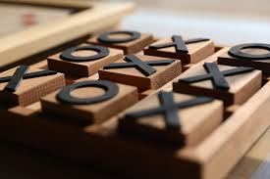
AI Decision Process
Analyzing Board States:
This means looking at the current Tic Tac Toe board and understanding where the marks ('X' or 'O') are placed.
Generating Possible Moves:
After analyzing the board, the AI or player thinks about all the different moves they can make.
Selecting the Optimal Move:
Once all possible moves are considered, the best move is chosen. This is the move that gives the player the best chance of winning or stopping the opponent from winning.

Slide 6
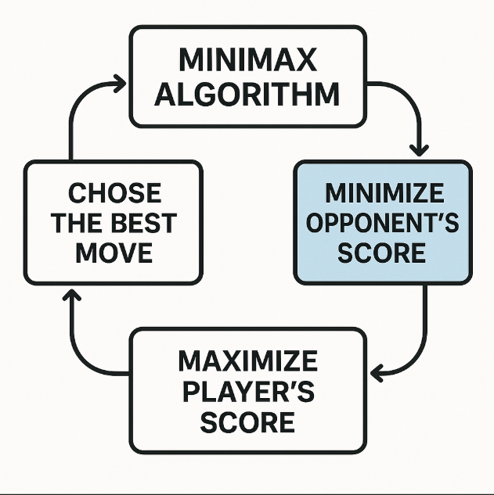
Minimax Algorithm
A decision-making algorithm used in game theory.
AI vs. Human: AI maximizes its score, Human minimizes it.
Explores all possible game states and selects the best move.
How Minimax Works
AI explores all possible moves.
Assigns values to different game states:
- Win = +10
- Lose = -10
- Draw = 0
Recursively calculates the best move.
Selects the move that maximizes AI's chance of winning.

Slide 7
Adding Alpha-Beta Pruning (Optimization)
Improves Minimax by eliminating unnecessary searches.
Alpha → Best value AI can achieve.
Beta → Best value opponent can achieve.
Pruning occurs when a move is worse than an already evaluated option.

Slide 8
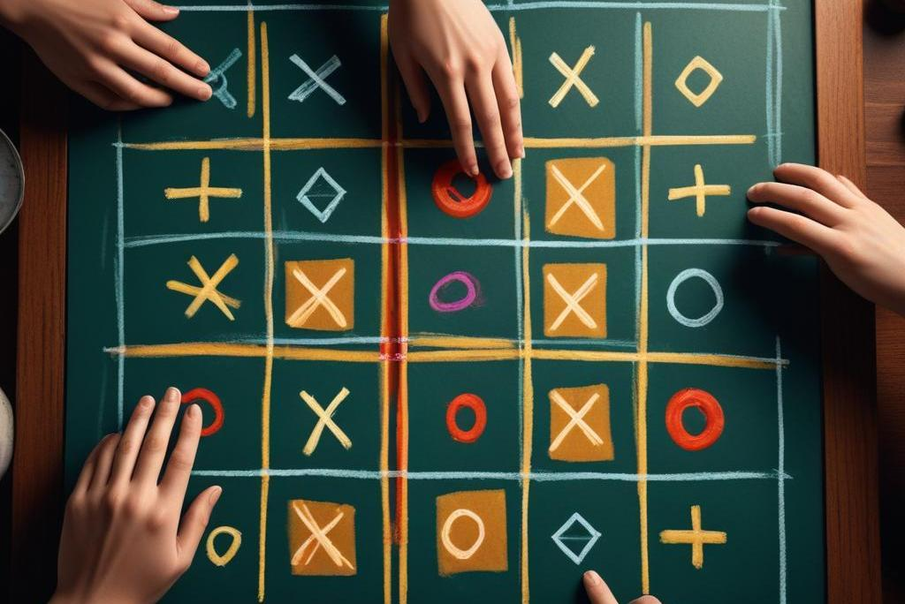
Tic-Tac-Toe Board Representation
Board as a 3x3 matrix (list of lists).
- Example:
['X', 'O', 'X']
['O', 'X', 'O']
[' ', ' ', ' ‘]

Slide 9
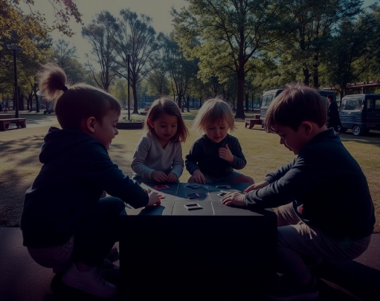
Conclusion: The Enduring Appeal of Tic-Tac-Toe
AI using Minimax is unbeatable.
Future improvements:
GUI version with Play game.
Adaptive AI (Reinforcement Learning).
Larger board sizes (4x4, 5x5, etc.).

Slide 10


